Slide 1
SASK LONG COVID PARTICIPANT PORTAL
CMPT 371 | Team 2 | ID 2

Slide 2
OUR LOVELY TEAM❤️❤️❤️
Project Manager | Build Manager | Risk Manager | Dev Lead | Devs | Test Lead | Testers
Jeet | Riley | Hari | Ini | Chi, Alex, Dillon | Sashti | Vaidehi, Herv

Slide 3
Changes/Adoptions in Technologies
We are using a template as foundation to work off of instead of building everything “from scratch”.
It will serve as a leaping point for us, and we’ll manipulate different features to fit our needs.
The authentication is one example of one change we will make.
In addition to username & password for login, we will add a “Request Account” page and have the admin manually approve the process.
Encryption is one other features to be implemented.

Slide 4
Current State of the System (Development)
Dashboard page has prototype timeline.
Register page created according to specs given by stakeholder.
Login authentication/validation not complete yet, but groundwork has been laid, just have to ensure all components (frontend, backend, db) are connected
Home page has timeline in table form.
Backend to Database connection set up.
Working on connecting the backend and frontend.

Slide 5
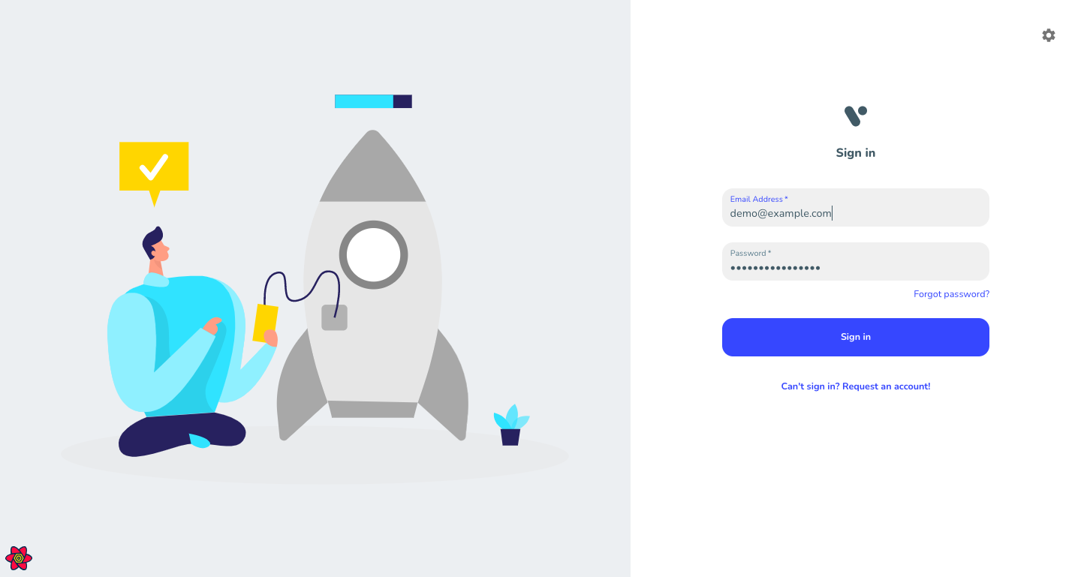

Slide 6
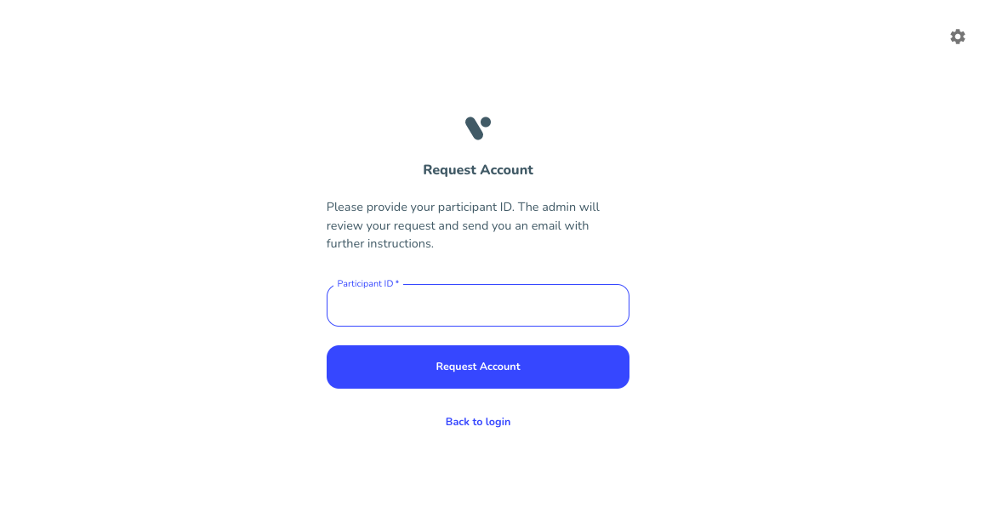

Slide 7
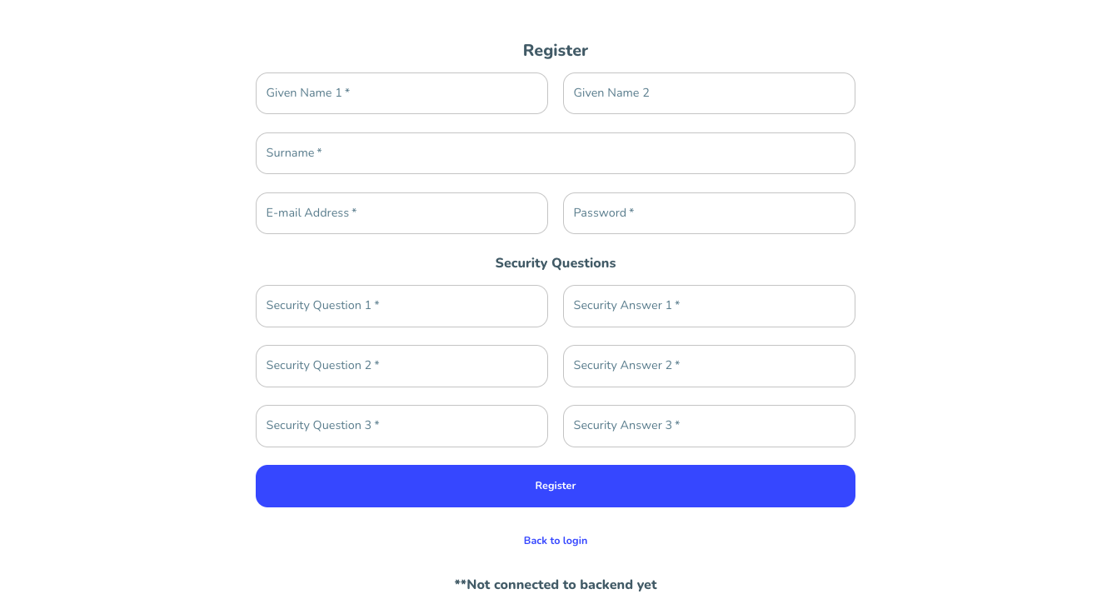

Slide 8
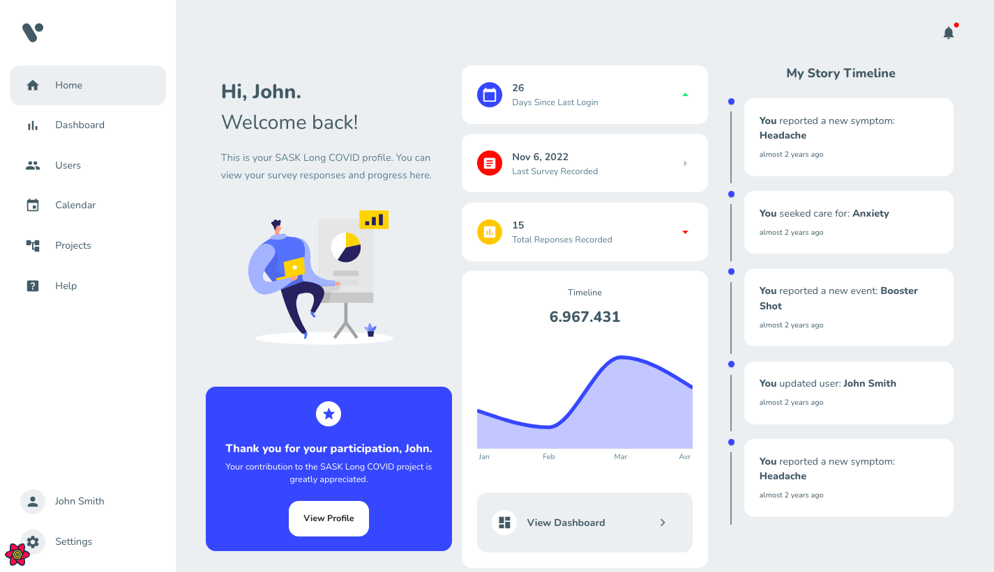

Slide 9
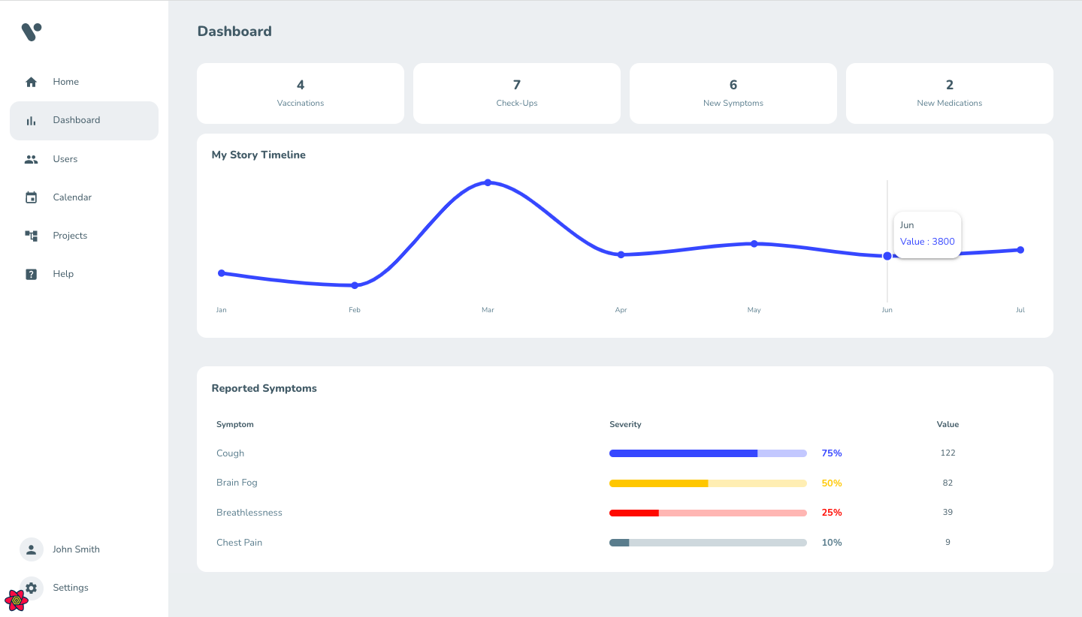

Slide 10
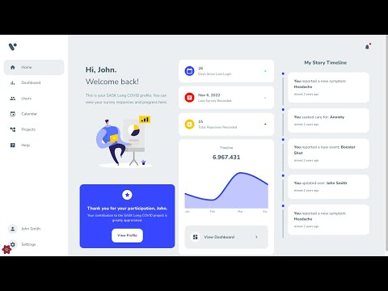

Slide 11
Current State of the System (Database)
Ability to connect to postgreSQL and make the appropriate tables
Ability to receive JSON data and post to the database
We used typeORM to set up the database tables on the backend, the entities, the function to receive and add a participant to the database with all their appropriate fields.

Slide 12
Test Plan and Testing in Place
For most of the UI Testing, Selenium will be used.
Testers will be performing manual testing for input based data.
Once the basic model of the website is working, with all the basic functions, Integration testing will be started as well.
Manual testing for the UI has been completed.
All the testing done so far on the website has been successfully passed.
Test team is still in process to set up Selenium testing so that automatic testing can be performed in future deliverables.

Slide 13
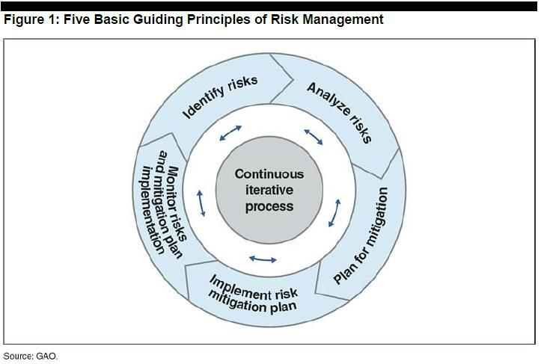
Potential Risks
Technical complexity of implementing a two-phase authentication system and multiple views of data.
Data privacy and security in the software handling sensitive medical data and personal information.
Risk of timelines and deliverables
Notes:
technical complexity of implementing a two-phase authentication system and multiple views of data.
Contingency plans enacted: could include having a backup team in place to take over if necessary or exploring alternative solutions if the original plan proves to be unfeasible.
Mitigation strategies applied: apply mitigation strategies such as providing additional training for team members, breaking the project down into smaller, more manageable tasks, and using testing and debugging techniques to identify and resolve any issues before they become major roadblocks. Additionally, the project should have clear and open lines of communication to ensure that any technical difficulties can be identified and addressed in a timely manner.
Data privacy and security in the software handling sensitive medical data and personal information
Top Risks: Conduct a thorough analysis of the software's existing security measures to identify any potential vulnerabilities or areas of risk. This should include a review of any third-party systems or services that the software interacts with, as well as the overall design and architecture of the system.
New Risks: Continuously monitor the software for new threats or vulnerabilities, and take proactive measures to address any new risks that are identified. This can include implementing software updates, using threat intelligence tools, or conducting regular security audits.
Contingency Plans: respond to a data breach or unauthorized access event. This should include procedures for quickly identifying and containing the breach, as well as steps for restoring access to the affected data and ensuring its privacy and security going forward.
Mitigation Strategies: Implement strategies to mitigate the risk of a data breach or unauthorized access, such as implementing encryption for sensitive data, using multi-factor authentication, or implementing access controls to limit who can access the data.
Risk Analysis: Conduct a regular risk analysis to assess the effectiveness of the software's existing security measures, and identify any areas where improvements can be made. This should involve a review of any new threats or vulnerabilities that have emerged, and a reassessment of the overall risk posture of the software and its environment.
Risk of timelines and deliverables:
Top risks identification: Look into potential risks that could impact the project timeline and deliverables, such as scope creep, resource constraints, and external factors that may affect the project timeline.
Risk analysis: Conduct a risk analysis to determine the likelihood and impact of each identified risk.
Contingency plans enacted: contingency plans to mitigate the impact of the identified risks, such as revising the project timeline, adjusting the budget, or allocating additional resources.
Mitigation strategies applied: mitigation strategies to reduce the likelihood of risks occurring or to lessen the impact of risks that do occur, such as proactive risk monitoring, implementing quality control measures, and stakeholder communication and collaboration.
Regular risk reviews: assess the effectiveness of the mitigation strategies, identify new risks that may arise, and update the contingency plans as needed.

Slide 14
Risk Management for Technical Complexity
Contingency plans enacted
could include having a backup team in place if required
Mitigation strategies applied
providing additional training for team members
breaking the project down into smaller, more manageable tasks
using testing and debugging techniques to identify and resolve any issues before they become major roadblocks

Slide 15
Risk Management for Data Privacy and Security
Conduct a thorough analysis of the software's existing security measures to identify any potential vulnerabilities or areas of risk.
Continuously monitor the software for new threats or vulnerabilities, and take proactive measures to address any new risks that are identified.
Respond to a data breach or unauthorized access event.
Implement strategies to mitigate the risk of a data breach or unauthorized access
Notes:
NOTES for:
Top Risks
This should include a review of any third-party systems or services that the software interacts with, as well as the overall design and architecture of the system.
New Risks
This can include implementing software updates, using threat intelligence tools, or conducting regular security audits.
Contingency plans:
This should include procedures for quickly identifying and containing the breach, as well as steps for restoring access to the affected data and ensuring its privacy and security going forward.

Slide 16
Risk management for timelines and deliverables
Potential risks that could impact the project timeline and deliverables.
Risk analysis to determine the likelihood and impact of each identified risk.
Contingency plans to mitigate the impact of the identified risks.
Mitigation strategies to reduce the likelihood of risks occurring or to lessen the impact of risks that do occur.

Slide 17

Tutorials Given
Time tracking:
We held a short meeting for everyone on how to use the Google Sheet for time tracking where Riley(build manager) showed everyone what to do.
Each member has their own sheet to update periodically.
Asana:
A quick tutorial by Riley to get everyone familiarized with the Scrum-ish method and Asana’s features for the dev and test teams.
Git functionality;
Steps on how to pull from the main branch or dev or test branch.
Steps for how to create a new branch for a new feature and work on it.
Steps for merging the new branch with the parent branch for dev and test branches.

Slide 18
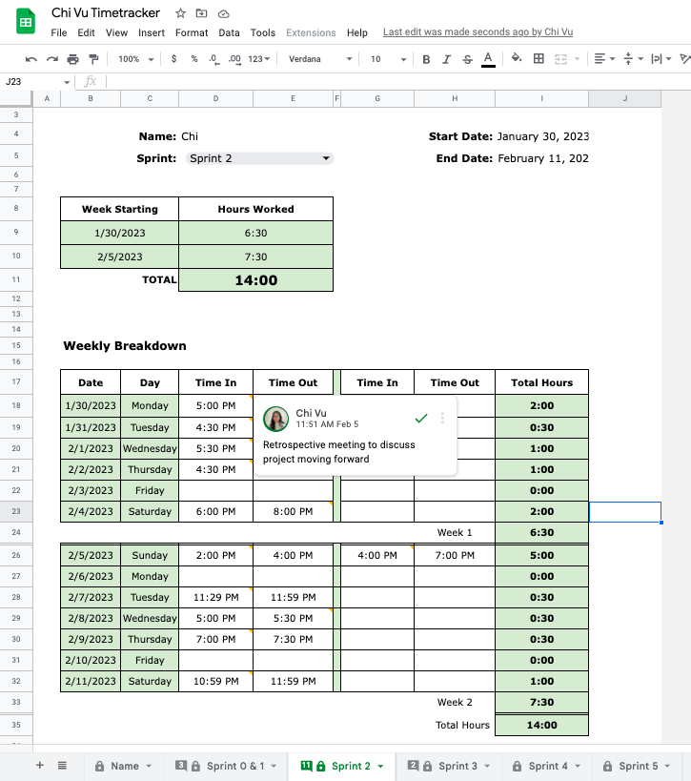
Time Tracking
Used spreadsheet template
Manually recorded time spent working on project: time started to time ended
Hours automatically calculated
6 Sprints corresponding to each deliverable
Comments help describe task completed per work session

Slide 19
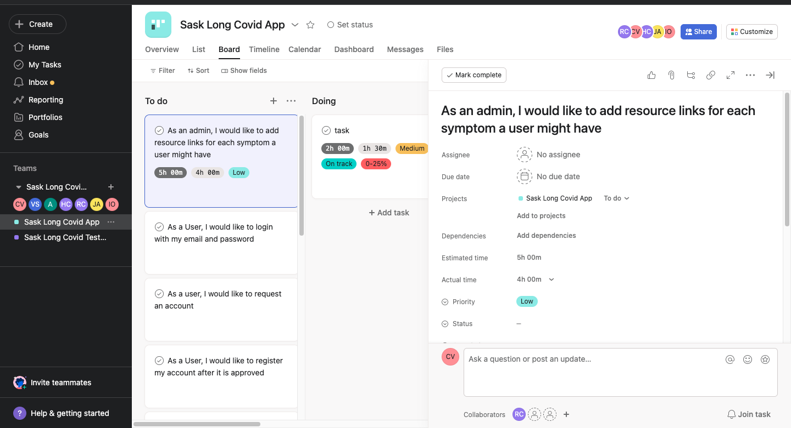
Actual vs Estimated Time
We plan to have an actual vs estimated time layout for the upcoming deliverable where we will keep tabs of the amount of time each member spent in a week.
We are also using Asana for delegation and prioritization of tasks for the dev and test teams as well as other members.
Using Asana, we will also see the status of completion of the given task using a percentage meter. Also, we will keep an estimated time for a task when a task is created.

Slide 20
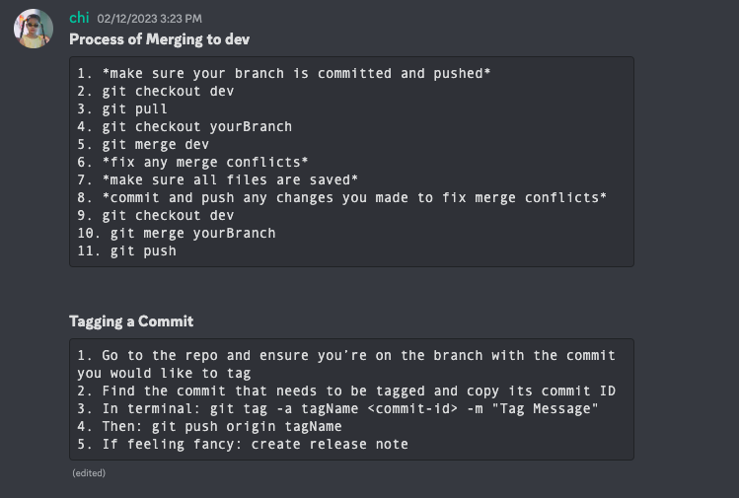
Git Functionality
Noted Steps for
Pull
Push
Merge

Slide 21
Inspections and Peer Reviews
Retrospective Inspections
Formal Peer Reviews

Slide 22

Retrospective Inspections
We had our retrospective inspection meeting on Tuesday Feb 7th, where we all sat down and discussed ID 1.
We realized some of the issues in our meeting structures and development styles
We all planned better this time to communicate more and meet more often for meetings.

Slide 23

Formal Peer Reviews
We decided to perform peer reviews for 4 members of our team at the very beginning of our first meeting for this deliverable.
We have a document that keeps track of peer reviews conducted so far. And that will keep a check on peer review count for everyone.
We are also keeping an eye for planned peer reviews vs actual peer reviews conducted since things are subject to change and it is a risk assessment to deliver the project better.
Our team split into teams to be efficient with peer reviews and saved time on it.
The people who were chosen for this deliverable are Dillon, Alex, Riley, and Herve.

Slide 24
Quality Assurance Practices
Code Reviews: effective ways to catch bugs
Automated Testing: involves writing tests that can be run automatically to validate the code's behavior and catch bugs
Continuous Integration: automatically building and testing code whenever changes are made – help to catch bugs before the commit
Code Documentation: involves writing comments and documentation that describe the purpose and behavior of the code – good for future reference and code maintenance
CI: We have a buffer branch named “dev” that is an intermediary “main” branch for any code that is not considered ready for production. Any code pushed to this branch will have all the tests triggered through Github Actions.

Slide 25
Plan for upcoming deliverable…
For Frontend:
We have partially met requirements by being able to add a participant but we don’t have the separate functionality for admins, and we cannot remove a participant from the database yet.
But we accomplished the features we needed for ID2 as far as the database is concerned.
For Testing:
Need to set up Selenium as soon as we can.
Test Cases and Code will be something that the test team will work on as well.
Travis CI will be used for Integration testing and will be set up by the next deliverable.

